Slide 1
VOIP

Slide 2
What is VoIP ?
IP TELPHONY (VOICE over IP)
Transmission of voice telephone calls
using internet infrastructure.
Three way to communicate:-
ATA
IP telephone
computers

Slide 3
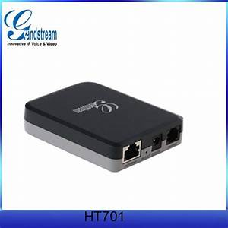
ATA
To connect analog telephone or similar devices to digital communication devices

Slide 4
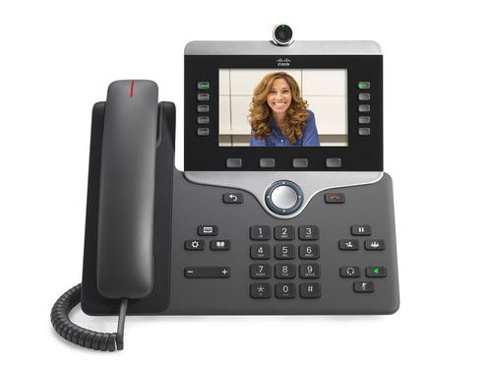
IP Telephony
Needs :- uses internet, IP routers
Not only voice but also video is transmitted using similar concepts.
Spreads at a fast pace.

Slide 5
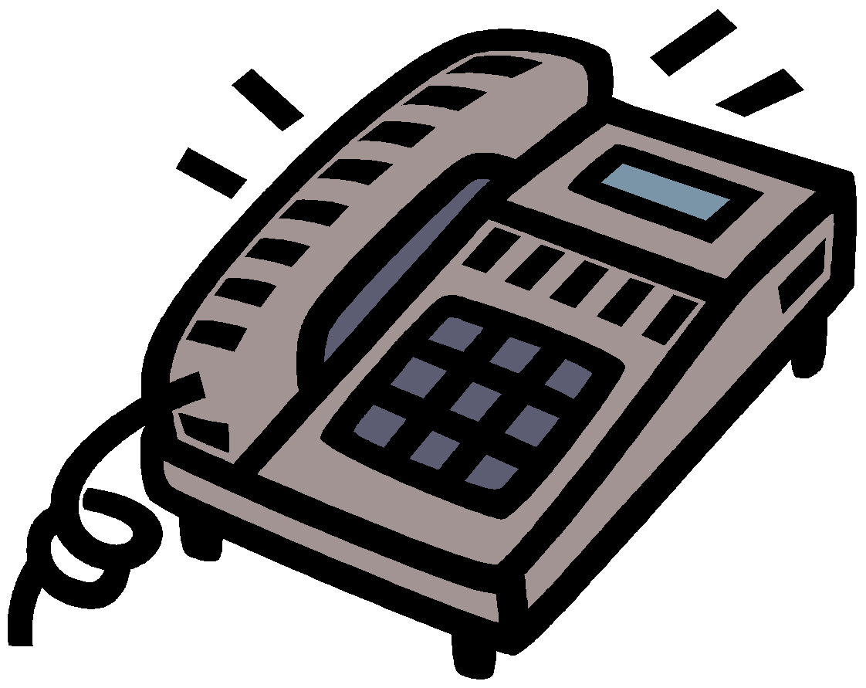
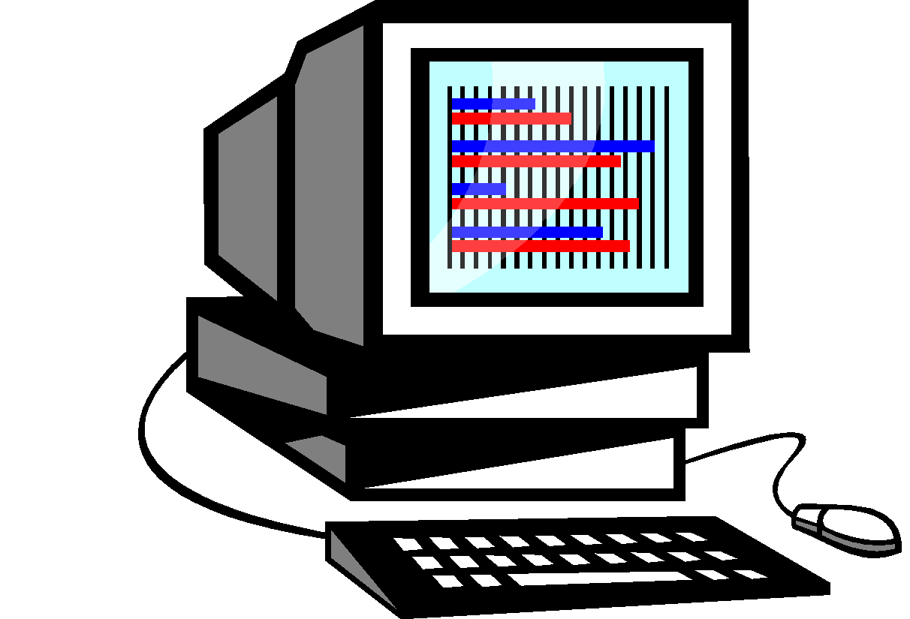
VoIP to VoIP
Broadband Network
VoIP
VoIP
Call Direction
IP Protocol

Slide 6

VoIP to POTS with Internet
Internet/Broadband
Kerala
New Delhi
PSTN
VoIP
Server/Gateway India
Call Direction
IP Protocol
(POTS:-plain old telephone service)

Slide 7
Basic Idea About VOIP
VoIP is a Layer 3 network protocol that uses various Layer 2 point-to-point or link-layer protocols such as PPP, Frame Relay, or ATM for its transport.
Two groups have introduced standards for IP telephony:-
ITU(International Telecommunications Union)
IETF(Internet Engineering Task Force)
The system must handle call setup by Phnumber to IP.
Convert each sample to digital form.Send the resulting digitized stream accross an IP network in packets.
Convert the stream back to analog for playback.

Slide 8
Basic Idea About VOIP(cont)
VIOP are in the RTP. So it uses UDP(User Datagram Protocol) for live communications.
Voice packets are transported via IP in compliance with a voice communications protocol or standard such as H.323, Media Gateway Control Protocol (MGCP), or Session Initiation Protocol (SIP)

Slide 9
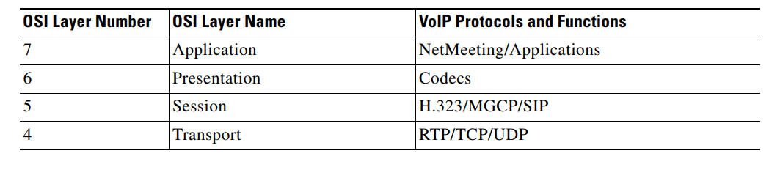
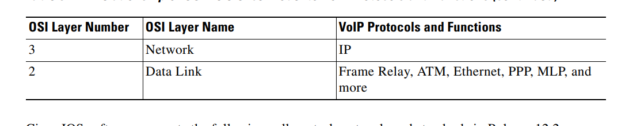
Relationship of OSI Reference Model to VoIP Protocols and Functions

Slide 10
VoIP Call Processing
The caller picks up the handset, signaling an off-hook condition to the signaling application layer of VoIP
The session application layer of VoIP issues a dial tone and waits for the caller to dial.
When the caller dials the number, the dialed digits are accumulated and stored by the session application.
After enough digits are accumulated to match a configured destination pattern, the telephone number is mapped to an IP host via the dial plan mapper. The IP host has a direct connection to the destination telephone number or a PBX that is responsible for completing the call to the configured destination pattern
The session application runs the H.323 session protocol to establish a transmission and a reception channel for each direction over the IP network. If the call is being handled by a PBX, the PBX forwards the call to the destination telephone. If Resource Reservation Protocol (RSVP) has been configured, the RSVP reservations are put into effect to achieve the desired quality of service (QoS) over the IP network.
The coder-decoders (codecs) are enabled for both ends of the connection and the conversation proceeds using RTP/UDP/Internet Protocol (IP) as the protocol stack. Voice signals are digitized, compressed, packaged into discrete packets, and transported over the network.

Slide 11
VoIP Call Processing (cont)
When either end of the call hangs up, the RSVP reservations are torn down (if RSVP is used) and the session ends. Each end becomes idle, waiting for the next off-hook condition to trigger another call setup.

Slide 12
Media Gateway Controller
Media gateway handles voice
IP telephone
Analog telephone
INTERNET
PSTN
Signaling gateway handles setup

Slide 13
SIP
The Session Initiation Protocol (SIP) is a communications protocol for signaling and controlling multimedia communication sessions in applications of Internet telephony for voice and video calls, in private IP telephone systems, as well as in instant messaging over Internet Protocol (IP) networks.
Session Initiation Protocol (SIP) is a peer-to-peer, multimedia signaling protocol developed in the IETF.
SIP is ASCII-based, resembling HTTP, and reuses existing IP protocols (DNS, SDP, etc.) to provide media setup and teardown.

Slide 14
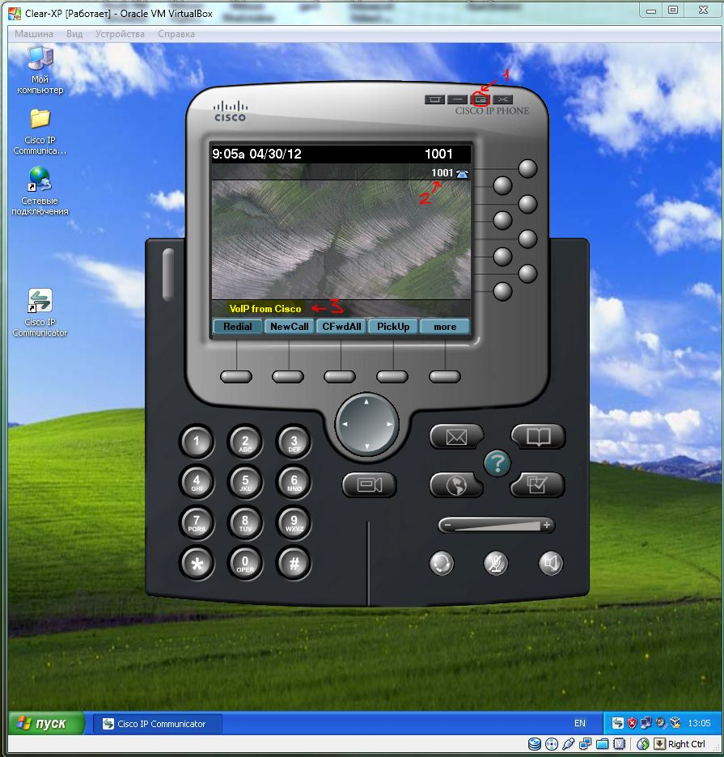
VIRTUAL IP PHONE

Slide 15
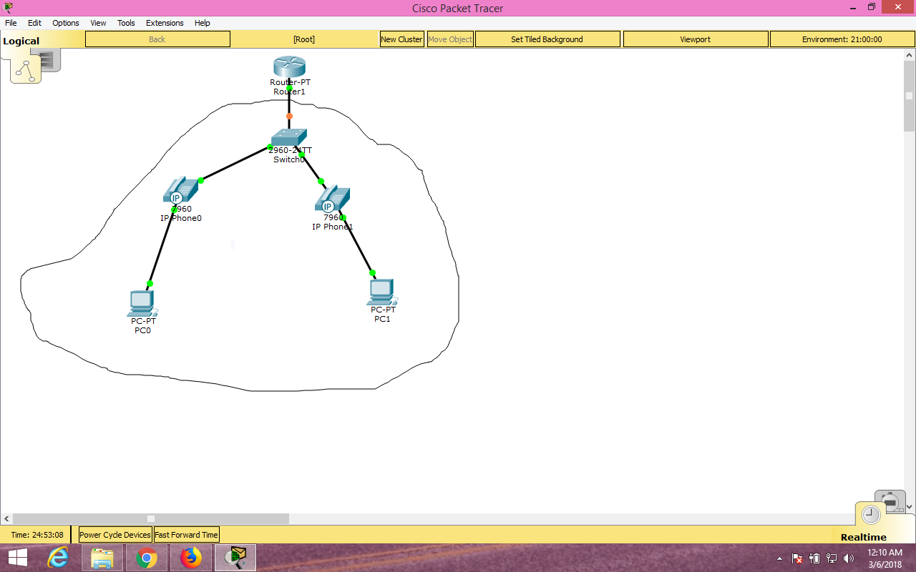
PACKET TRACER

